Slide 1

Displaying Leaves in BST
Subject - Python
Explained by - S Shashank
RNSIT, Bangalore
www.intellify.in A joint effort by Intellify and NSS IIT Delhi info@intellify.in

Slide 2
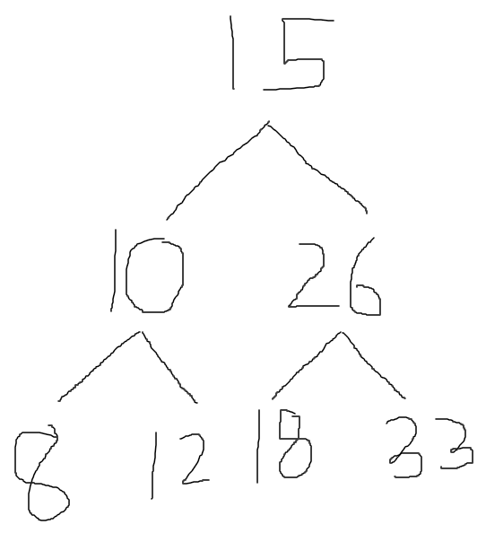
Problem Statement
Write a program to Print the leaf nodes of a Binary Search Tree.
e.g. Input :
Output : 8, 12, 18, 33
5
35
25
22
15
www.intellify.in S Shashank, RNSIT Bangalore

Slide 3
Creating the Binary Search Tree
class Node : left, right, val
left – left child
right – right child
val – key of node
5
35
25
22
15
www.intellify.in S Shashank, RNSIT Bangalore

Slide 4
Insertion of values into BST
4
Insert root node
For each of the next values check
If value greater than parent, make it the right child
If value lesser than parent, make it the left child
4
35
25
15
www.intellify.in S Shashank, RNSIT Bangalore

Slide 5
Checking for leaf nodes
4
Uses two stacks(lists)
Stack1 : Store all nodes
Stack2 : Store leaf nodes
A node is a leaf if it does not have any children
4
25
22
15
www.intellify.in S Shashank, RNSIT Bangalore

Slide 6
Thank you
www.intellify.in S Shashank, RNSIT Bangalore

